Slide 1
Tagging and Hidden Markov Models

Slide 2
Machine learning and natural language processing
First step: Forget (almost) everything I told you about natural language processing. It’s not just different methods, it’s a completely different game.
You have a corpus of text:
sometimes labelled by paid labelers (comparatively small and expensive),
sometimes labeled by the world at large (e.g. reviews with stars).
sometimes unlabeled (often enormous).
You have a specific task and evaluation metric. Use machine learning. To some extent, variants of the methods we’ve discussed, to some extent new techniques.

Slide 3
Tagging problem
You have a sequence of elements. You want to assign a tag to each element.
Examples:
Element = word. Tag = part of speech, or some other category.
Element = phoneme in audio speech. Tag = component of a word.
Corpus: A large collection of sequences of elements with tags. For English texts and parts of speech tags, there are standard million- word corpora. (Brown corpus, Penn tree bank).
For phonemes, this is recorded speech plus a transcript.

Slide 4
Probabilistic model
e₁,e₂, … , e_{n}: elements
t₁, t₂, … , t_{n}: tags
Given a sequence of elements, find the most probable sequence of tags.
P(t₁, t₂, … , t_{n} | e₁,e₂, … , e_{n}) = (Bayes’ law)
P(e₁,e₂, … , e_{n} | t₁, t₂, … , t_{n} )∙ P(t₁, t₂, … , t_{n} )/ P(e₁,e₂, … , e_{n} )
Ignore the denominator, since that’s fixed.

Slide 5
Independence assumption 1
Given tag t_{i}, element e_{i} is conditionally independent of all the other elements and tags.
P(e₁,e₂, … , e_{n} | t₁, t₂, … , t_{n} ) =
P(e₁ | t₁) ∙ P(e₂ | t₂) ∙ … ∙ P(e_{n} | t_{n})
Again apply Bayes’ law
P(e₁ | t₁) = P(t₁ | e₁) ∙ P(e₁) / P(t₁).
Ignore P(e₁) since that’s fixed.

Slide 6
Independence assumption 2: K-gram assumption
k can be any value, but we’ll take k=3, which is often used.
Independence assumption:
Given the previous two (in general, k−1) tags, a tag is conditionally independent of all the earlier ones.
Given t₂ and t₃, t₄ is conditionally independent of t₁
Given t₃ and t₄, t₅ is conditionally independent of t₁ and t₂
Given t₄ and t₅, t₆ is conditionally independent of t₁ t₂ and t₃
…

Slide 7
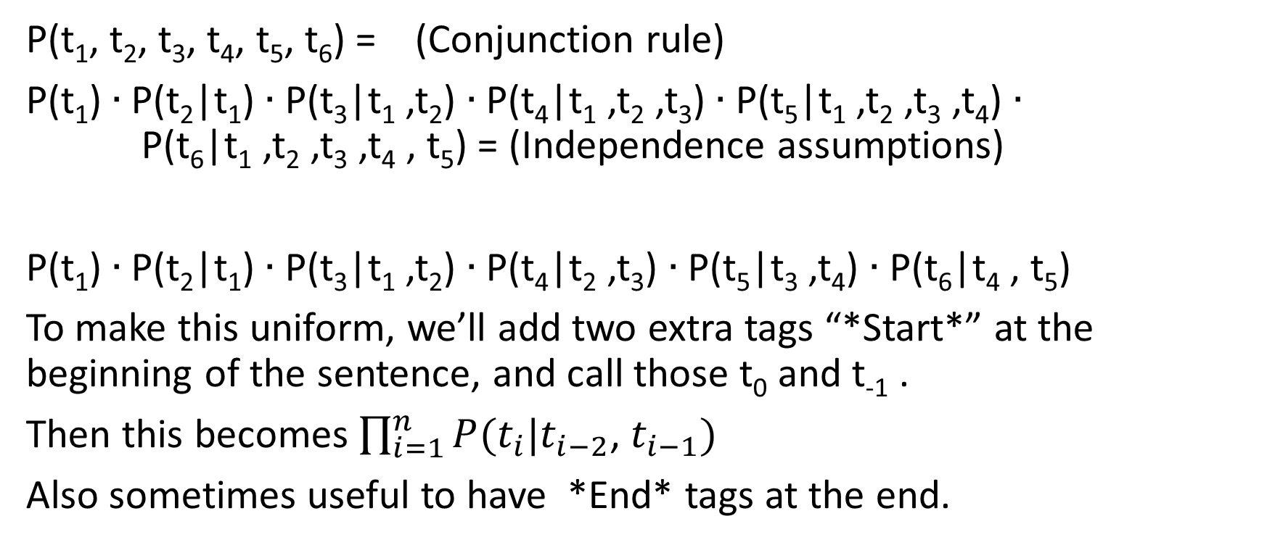
K-gram assumption
P(t₁, t₂, t₃, t₄, t₅, t₆) = (Conjunction rule)
P(t₁) ∙ P(t₂|t₁) ∙ P(t₃|t₁ ,t₂) ∙ P(t₄|t₁ ,t₂ ,t₃) ∙ P(t₅|t₁ ,t₂ ,t₃ ,t₄) ∙ P(t₆|t₁ ,t₂ ,t₃ ,t₄ , t₅) = (Independence assumptions)
P(t₁) ∙ P(t₂|t₁) ∙ P(t₃|t₁ ,t₂) ∙ P(t₄|t₂ ,t₃) ∙ P(t₅|t₃ ,t₄) ∙ P(t₆|t₄ , t₅)
To make this uniform, we’ll add two extra tags “*Start*” at the beginning of the sentence, and call those t₀ and t₋₁ .
Then this becomes $\prod_{i=1}^{n}{P(t_{i}|t_{i−2}}$, $t_{i−1})$
Also sometimes useful to have *End* tags at the end.

Slide 8
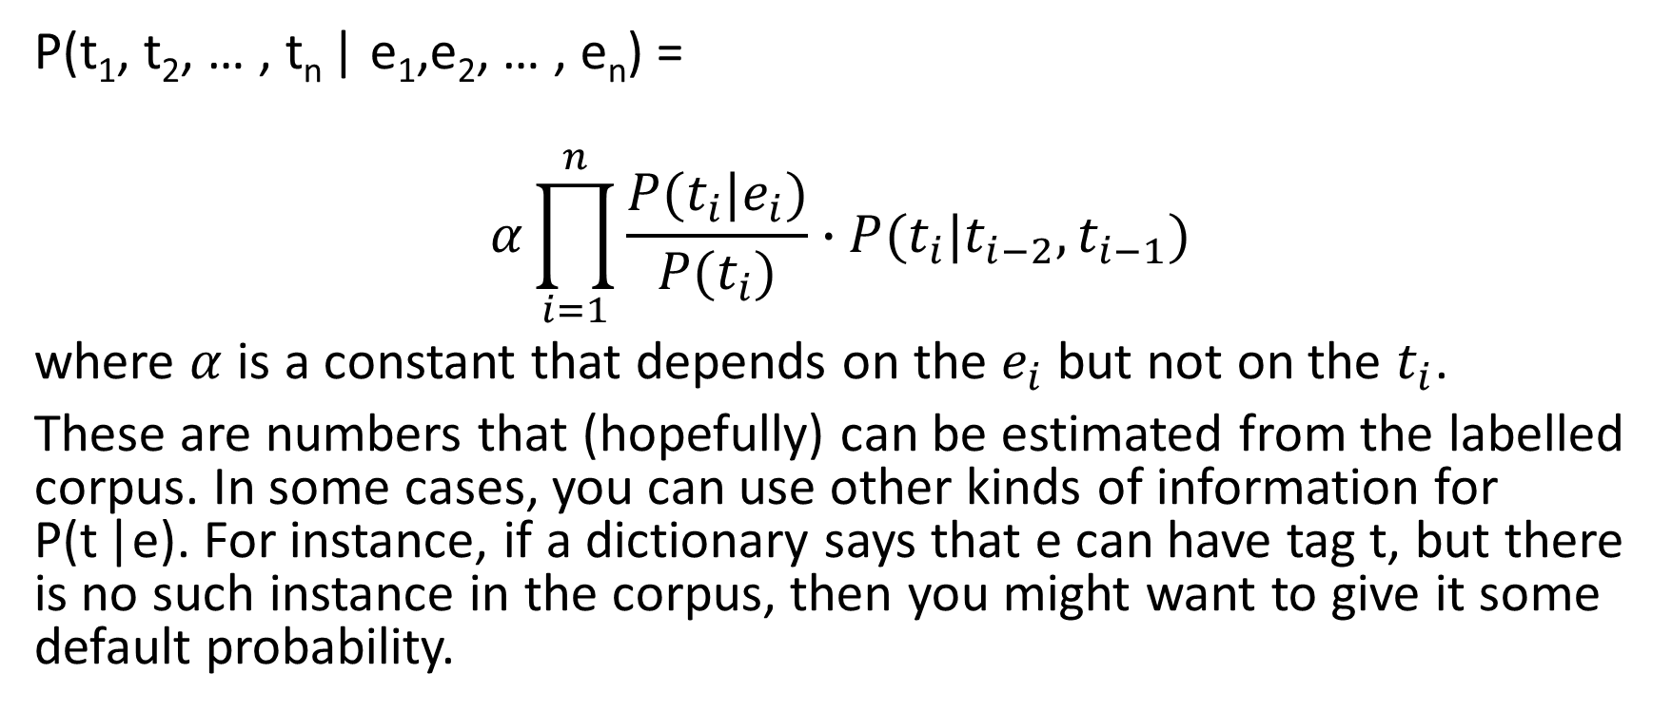
Putting this together
P(t₁, t₂, … , t_{n} | e₁,e₂, … , e_{n}) =
$$α\prod_{i=1}^{n}{\frac{P(t_{i}|e_{i})}{P(t_{i})}∙P(t_{i}|t_{i−2},t_{i−1})}$$
where $α$ is a constant that depends on the $e_{i}$but not on the $t_{i}$.
These are numbers that (hopefully) can be estimated from the labelled corpus. In some cases, you can use other kinds of information for P(t |e). For instance, if a dictionary says that e can have tag t, but there is no such instance in the corpus, then you might want to give it some default probability.

Slide 9
Hidden Markov Model
A state is a pair (a k-1 tuple) of tags – the last two tags you’ve seen.
Arcs are labelled with elements and with probabilities.
There is an arc from state <TA,TB> to <TB,TC> labelled E if P(TC|E)>0 and P(TC|TA,TB) > 0. That is, if element E can have tag TC, and TC can follow TA,TB.
So the structure is the same as MDPs, with elements instead of actions.
But the problem is different: You are given the sequence of elements, and you want to find the most probable path through the graph.

Slide 10
Toy example: Part of speech tagging
Sentence: “fish can swim fast”
Tags: Noun, Verb, Modal, Adverb
“fish” can be a Noun or a Verb.
“can” can be a Modal, a Noun, or a Verb.
“swim” can be a Verb or a Noun.
“fast” can be an Adverb, a Verb, or a Noun (or an Adjective).

Slide 11
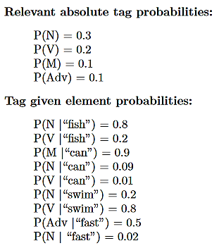
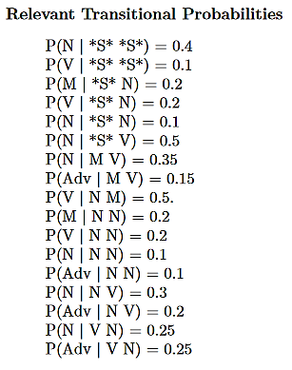
Numbers (made up. In reality they would be gathered from a text corpus.)

Slide 12
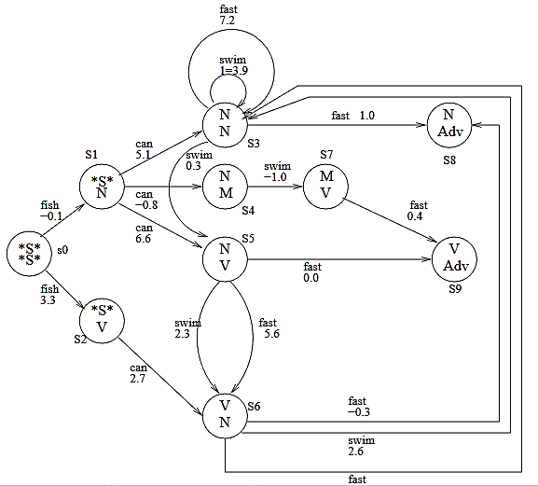
HMM. Numbers are the negative log₂ unnormalized probabilities

Slide 13
Shortest path problem
Viterbi’s algorithm
Variant of Dijkstra’s algorithm
Time O(nk²) (n=length of sentence; k=number of states)

